Slide 1



PRODUCT SALES ANALYSIS USING MACHINE LEARNING

Slide 2


CONTENT
01
INTRODUCTION
DATA COLLECTION AND PREPARATION FOR MACHINE LEARNING
02
TYPES OF MACHINE LEARNING ALGORITHM
03
04
IMPLEMENTATION OF MACHINE ALGORITHM
05
CONCLUSION

Slide 3


How Machine Learning Algorithm
can help you predict sales trends
and customer behaviour
Machine learning algorithms require quality data for training and ongoing monitoring to remain accurate and relevant. It's important to continuously refine models and adapt them to changing market conditions and customer preferences. Additionally, the choice of the right algorithm depends on the specific problem and available data. A combination of various machine learning techniques and domain knowledge is often necessary to gain valuable insights into sales trends and customer behavior.

Slide 4
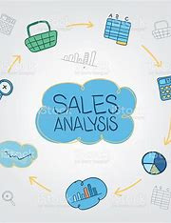
INTRODUCTION
The future of product sales analysis lies in the synergy between human expertise and machine learning algorithms. By combining the intuition and experience of sales professionals with the analytical capabilities of machine learning, businesses can unlock new opportunities, identify hidden patterns, and adapt to the ever-evolving market dynamics.
This innovation document outlines a proposal to enhance the existing product sales analysis project by implementing innovative features to provide deeper insights and improve decision-making

Slide 5

Data Collection and Preparation for Machine Learning
Define the problem:
Clean and prepare data :
Normalizes Normalizes the data :
Before you start collecting data,you to determine the what question you want to answer or what problem you want to solve
You need to collect and relevant the data and clean it so it is in the appropriate format for analysis
Normalize ensure the data is in the consistent model allow for the analysis the performance

Slide 6


TYPES OF MACHINE LEARNING ALGORITHM FOR PREDICT SALES AND TRENDS
1.SUPERVISED LEARNING ALGORITHM
Train model using labelled data to prediction or classification
2.UNSUPERVISED LEARNING ALGORITHM
Discover patterns and structure in unlabeled data without predefined categories
3.REINFORCEMENT LEARNING ALGORITHM
Learn through interaction with an environment to maximize reward and minimize penalties

Slide 7
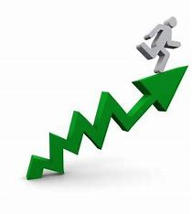




IMPLEMENTING Machine Learning Algorithm
CHOOSE THE RIGHT ALGORITHM
MAKE PREDICTION
TRAIN THE MODEL
finally used your trained data to predict the future for sales trends
Based on your specific needs choose an algorithm that can efficientlyanalysis
Feed the algorithm to your data to train the model and analysis the predictions

Slide 8


Evaluating and refining Prediction
CONFUSION MATRIX
A table that help to you that determone the accuracy of model predictions
03
CROSS VALIDATIONS
02
A technique for testing a model efficiently the data dividing ito testing and training
FEATURE IMPORTANCE
01
A feature importance that determines the feature which data is most important for data set

Slide 9

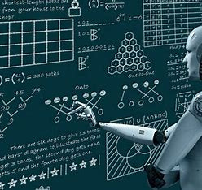
Conclusion and Consider the future implemenation
Effective data collection and preparation significantly impact the success of your machine learning project. It requires a combination of domain expertise, data analysis skills, and knowledge of the specific machine learning algorithms you intend to use. It's an iterative process, and refining your data preparation techniques as you gain insights is often necessary for improving model performance.

